Slide 1


AAA COLLEGE OF ENGINEERING AND TECHNOLOGY
traffic analysis attack for identiying user’s online activities
Presented By
S.Madhavan ( 953720106020 )
N.Kutbudeenshait ( 953720106019 )
Project Supervisor
P.Samayan A.P / ECE

Slide 2
ABSTRACT

Slide 3
The open nature of the wireless medium leaves it vulnerable to intentional interference attacks, typically referred to as jamming. This intentional interference with wireless transmissions can be used as a launchpad for mounting Denial-of-Service attacks on wireless networks. Typically, jamming has been addressed under an external threat model. However, adversaries with internal knowledge of protocol specifications and network secrets can launch low-effort jamming attacks that are difficult to detect and counter. In this work, we address the problem of selective jamming attacks in wireless networks. In these attacks, the adversary is active only for a short period of time, selectively targeting messages of high importance. We illustrate the advantages of selective jamming in terms of network performance degradation and adversary effort by presenting two case studies; a selective attack on TCP and one on routing. We show that selective jamming attacks can be launched by performing real-time packet classification at the physical layer. To mitigate these attacks, we develop three schemes that prevent real-time packet classification by combining cryptographic primitives with physical-layer attributes. We analyze the security of our methods and evaluate their computational and communication overhead.

Slide 4
LITERATURE SURVEY
V. Taylor, R. Spolaor, and M. Conti, “Robust smartphone app identification via encrypted network traffic analysis,”IEEE Transactions on Information Forensics and Security,vol. 13, no 1, pp. 63–78, Jan. 2019.
The apps installed on a smartphone can reveal much information about a user, such as their medical conditions, sexual orientation, or religious beliefs. In addition, the presence or absence of particular apps on a smartphone can inform an adversary, who is intent on attacking the device. In this paper, we show that a passive eavesdropper can feasibly identify smartphone apps by fingerprinting the network traffic that they send. Although SSL/TLS hides the payload of packets, side-channel data, such as packet size and direction is still leaked from encrypted connections. We use machine learning techniques to identify smartphone apps from this side-channel data. In addition to merely fingerprinting and identifying smartphone apps, we investigate how app fingerprints change over time, across devices, and across different versions of apps. In addition, we introduce strategies that enable our app classification system to identify and mitigate the effect of ambiguous traffic, i.e., traffic in common among apps, such as advertisement traffic. We fully implemented a framework to fingerprint apps and ran a thorough set of experiments to assess its performance. We fingerprinted 110 of the most popular apps in the Google Play Store and were able to identify them six months later with up to 96% accuracy. Additionally, we show that app fingerprints persist to varying extents across devices and app versions.

Slide 5
MODULE DESCRIPTION

Slide 6
NETWORK MODULE
We address the problem of preventing the jamming node from classifying m in real time, thus mitigating J’s ability to perform selective jamming.
The network consists of a collection of nodes connected via wireless links. Nodes may communicate directly if they are within communication range, or indirectly via multiple hops. Nodes communicate both in unicast mode and broadcast mode. Communications can be either unencrypted or encrypted. For encrypted broadcast communications, symmetric keys are shared among all intended receivers. These keys are established using preshared pairwise keys or asymmetric cryptography.

Slide 7
REAL TIME PACKET CLASSIFICATION
Consider the generic communication system depicted in Fig. At the PHY layer, a packet m is encoded, interleaved, and modulated before it is transmitted over the wireless channel. At the receiver, the signal is demodulated, deinterleaved, and decoded, to recover the original packet m.
Moreover, even if the encryption key of a hiding scheme were to remain secret, the static portions of a transmitted packet could potentially lead to packet classification. This is because for computationally-efficient encryption methods such as block encryption, the encryption of a prefix plaintext with the same key yields a static ciphertext prefix. Hence, an adversary who is aware of the underlying protocol specifics (structure of the frame) can use the static cipher text portions of a transmitted packet to classify it.

Slide 8
SELECTIVE JAMMING MODULE
We illustrate the impact of selective jamming attacks on the network performance. Implement selective jamming attacks in two multi-hop wireless network scenarios. In the first scenario, the attacker targeted a TCP connection established over a multi-hop wireless route. In the second scenario, the jammer targeted network-layer control messages transmitted during the route establishment process selective jamming would be the encryption of transmitted packets (including headers) with a static key. However, for broadcast communications, this static decryption key must be known to all intended receivers and hence, is susceptible to compromise. An adversary in possession of the decryption key can start decrypting as early as the reception of the first ciphertext block.

Slide 9
STRONG HIDING COMMITMENT SCHEME (SHCS)
We propose a strong hiding commitment scheme (SHCS), which is based on symmetric cryptography. Our main motivation is to satisfy the strong hiding property while keeping the computation and communication overhead to a minimum.
The computation overhead of SHCS is one symmetric encryption at the sender and one symmetric decryption at the receiver. Because the header information is permuted as a trailer and encrypted, all receivers in the vicinity of a sender must receive the entire packet and decrypt it, before the packet type and destination can be determined. However, in wireless protocols such as 802.11, the complete packet is received at the MAC layer before it is decided if the packet must be discarded or be further processed . If some parts of the MAC header are deemed not to be useful information to the jammer, they can remain unencrypted in the header of the packet, thus\ avoiding the decryption operation at the receiver.

Slide 10
CRYPTOGRAPHIC PUZZLE HIDING SCHEME (CPHS)
We present a packet hiding scheme based on cryptographic puzzles. The main idea behind such puzzles is to force the recipient of a puzzle execute a pre-defined set of computations before he is able to extract a secret of interest. The time required for obtaining the solution of a puzzle depends on its hardness and the computational ability of the solver. The advantage of the puzzlebased scheme is that its security does not rely on the PHY layer parameters. However, it has higher computation and communication overhead
We consider several puzzle schemes as the basis for CPHS. For each scheme, we analyze the implementation details which impact security and performance. Cryptographic puzzles are primitives originally suggested by Merkle as a method for establishing a secret over an insecure channel. They find a wide range of applications from preventing DoS attacks to providing broadcast authentication and key escrow schemes

Slide 11
SOFTWARE SPECIFICATION

Slide 12
Operating System : Windows 11
Technology Used : Java, JDK 1.6

Slide 13
EXISTING SYSTEM

Slide 14
Jamming attacks are much harder to counter and more security problems. They have been shown to actualize severe Denial-of-Service (DoS) attacks against wireless networks. In the simplest form of jamming, the adversary interferes with the reception of messages by transmitting a continuous jamming signal , or several short jamming pulses jamming attacks have been considered under an external threat model, in which the jammer is not part of the network. Under this model, jamming strategies include the continuous or random transmission of high power interference signals.
DISADVANTAGES OF EXISTING SYSTEM
They have been shown to actualize severe Denial-of-Service (DoS) attacks against wireless networks.
The simplest form of jamming, the adversary interferes with the reception of messages by transmitting a continuous jamming signal
Jamming strategies include the continuous or random transmission of high power interference signals.

Slide 15
PROPOSED SYSTEM

Slide 16
ADVANTAGES OF PROPOSED SYSTEM
We address the problem of jamming under an internal threat model. We consider a sophisticated adversary who is aware of network secrets and the implementation details of network protocols at any layer in the network stack.
The adversary exploits his internal knowledge for launching selective jamming attacks in which specific messages of “high importance” are targeted.
Jammer may decode the first few bits of a packet for recovering useful packet identifiers such as packet type, source and destination address.
Communication is easy and fast between people.
Saves time.

Slide 17
DATA FLOW DIAGRAM

Slide 18
DATA FLOW DIAGRAM
Level 0
Source
Select the File to Send
Channel Encoding & Interleaving
Send Packet

Slide 19
Level 1
Destination
De-Interleaving the Data
Channel Decoding
Show Packets
Level 2
Packet Hiding
Monitors the Packet
Receiving Packets

Slide 20
USE CASE DIAGRAM

Slide 21
SEQUENCE DIAGRAM

Slide 22
ACTIVITY DIAGRAM

Slide 23
SCREENSHOTS

Slide 24
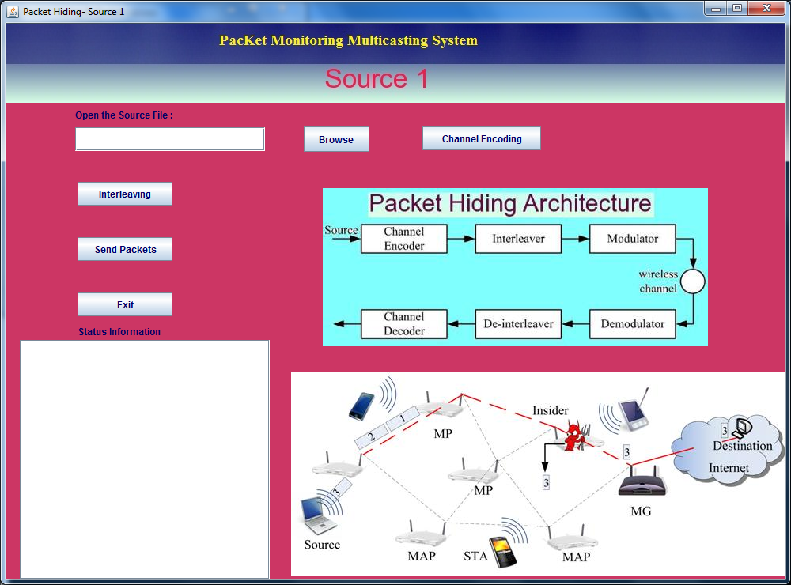
Source

Slide 25
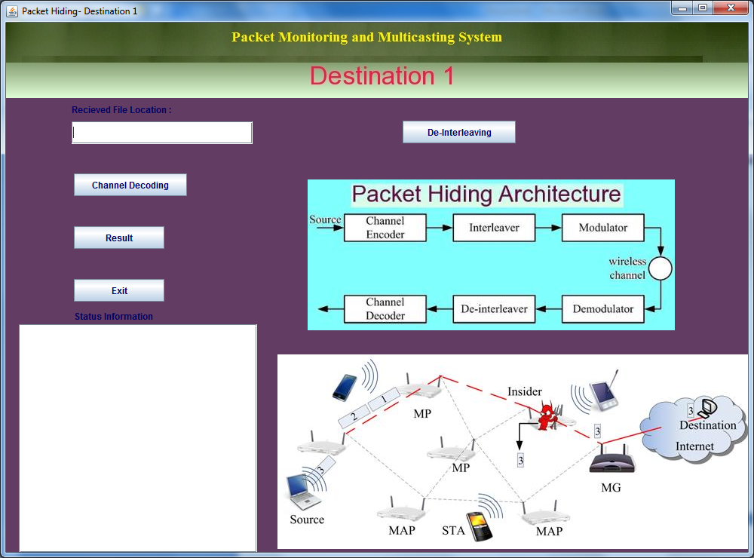
Destination

Slide 26
Packet Hiding Queue

Slide 27
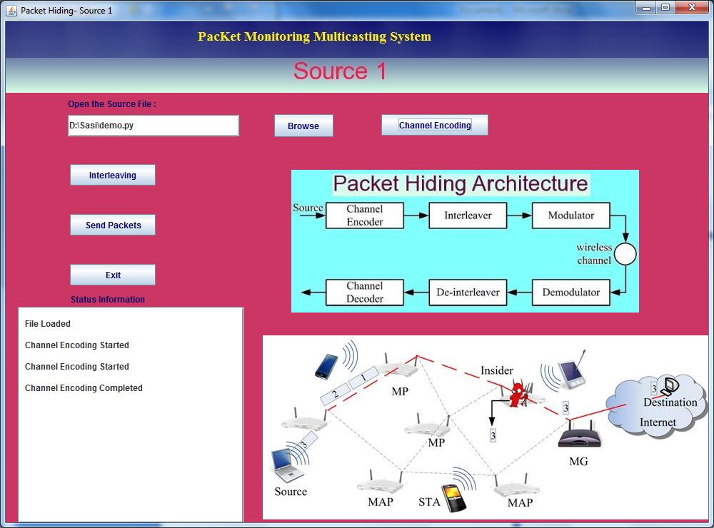
File Selection & Encoding the Packets

Slide 28
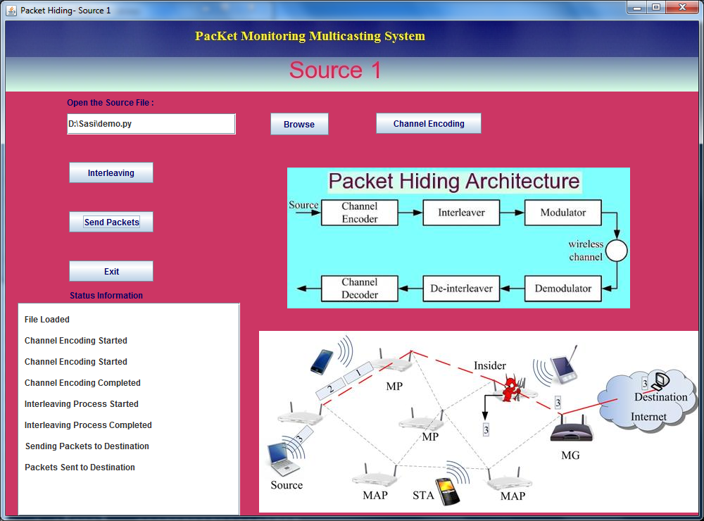
Packets Interleaving & send Packets

Slide 29
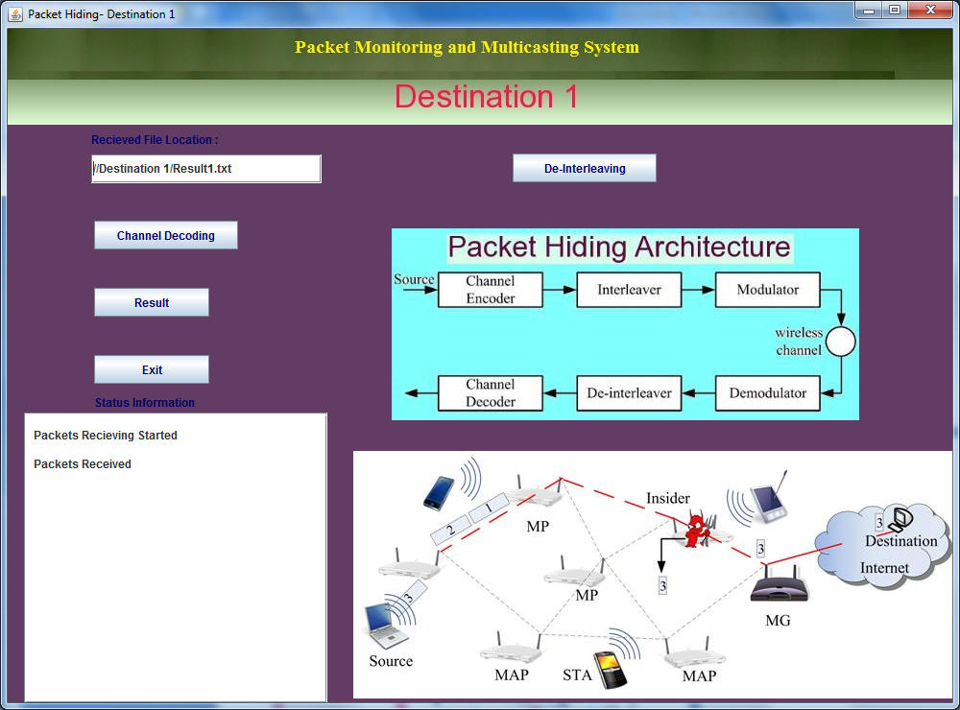
Packets received from Source

Slide 30
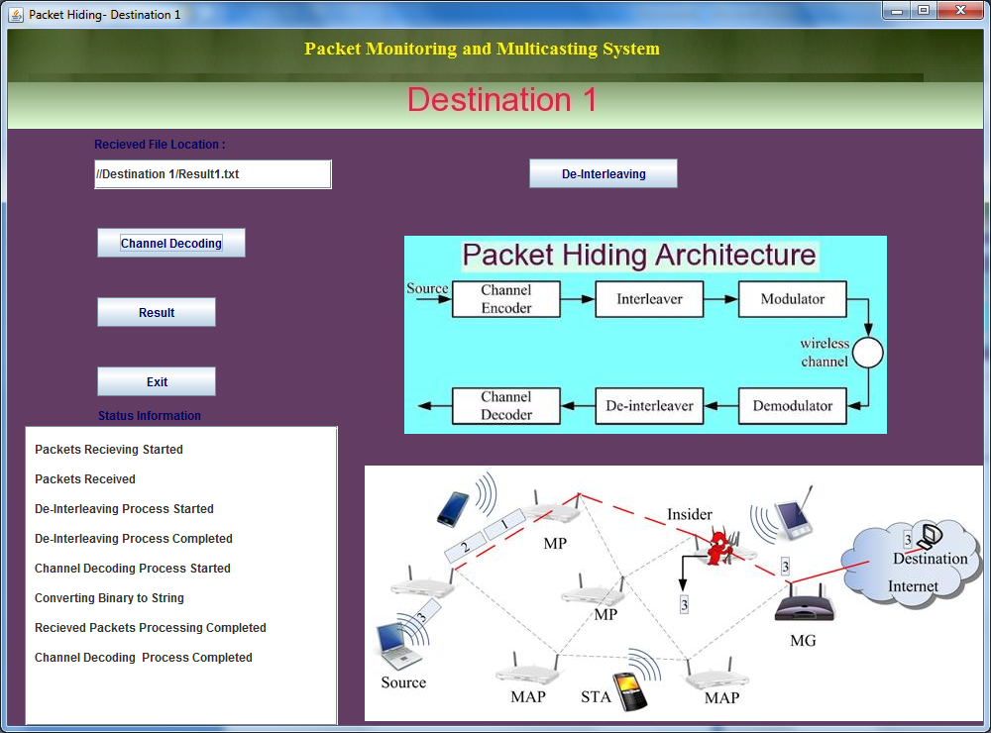
Deinterleaving & Decoding

Slide 31
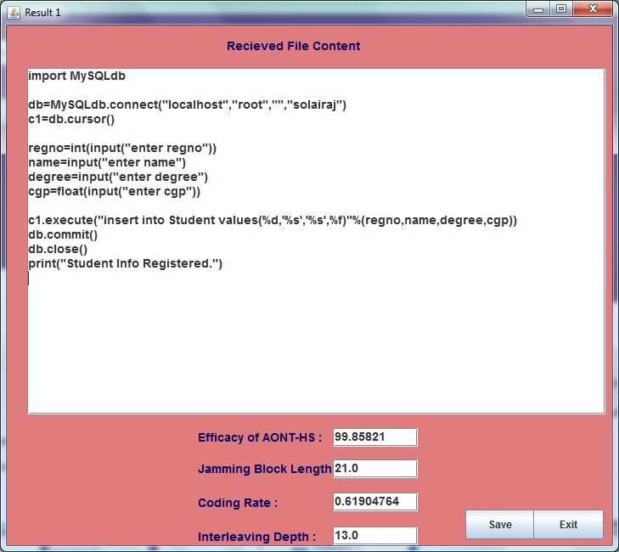
Show the Packets & download

Slide 32
Coding Selection of Software
The Java programming language is a high-level language that can be characterized by all of the following buzzwords:
Simple
Architecture neutral
Object oriented
Portable
Distributed
High performance
Interpreted
Multithreaded
Robust
Dynamic

